Slide 1
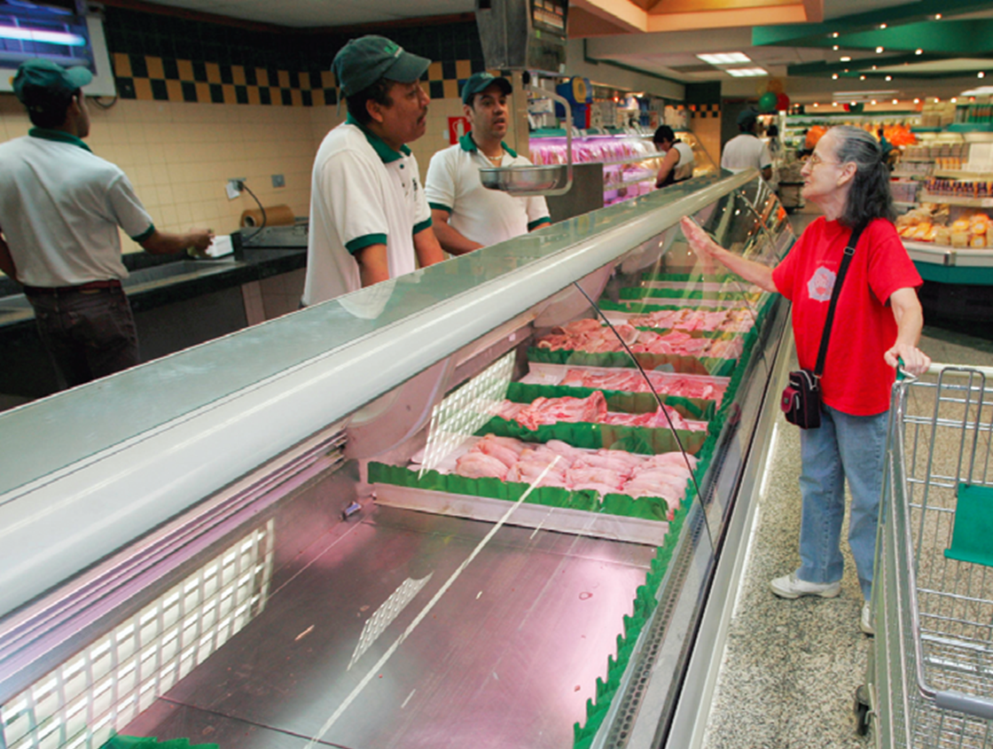
Price Ceilings
Venezuela’s food shortages: Price ceilings may be well intentioned but are usually not a good idea.

Slide 2
Price Controls
Price controls: legal restrictions on how high or low a market price may go.
There are two main types:
Price ceiling: a maximum price sellers are allowed to charge (usually set BELOW equilibrium).
Price floor: a minimum price buyers are required to pay (usually set ABOVE equilibrium).

Slide 3
The Effects of a Price Ceiling: Shortage
Monthly rent (per apartment)
$1,400
S
1,200
E
1,000
Price ceiling
A
B
800
Housing shortage of 400,000 apartments caused by price ceiling
600
D
0
1.6
1.8
2.0
2.2
2.4
Quantity of apartments (millions)

Slide 4
A Price Ceiling Causes Inefficiently Low Quantity & Low Quality
The shortages lead to higher prices $1200, as consumers are willing to pay higher.
Inefficiency: Deadweight Loss: the triangle area to the left of Equilibrium E,
is the result of lower quantity and higher price: ½ x (1200-800) x (2.0-1.8).
Monthly rent
(per apartment)
$1,400
S
1,200
E
1,000
Price ceiling
800
600
D
0
1.6
1.8
2.0
2.2
2.4
Quantity of apartments (millions)
Quantity supplied with rent control
Quantity supplied without rent control

Slide 5
Binding, or Effective, Price Ceilings
Monthly rent (per apartment)
If a price ceiling is set above equilibrium, it will have no effect (called nonbinding).
$1,400
S
Nonbinding
price ceiling
1,200
Only a price ceiling that forces price below equilibrium will have any effect (called binding or effective).
E
1,000
A
B
800
Binding, or effective, price ceiling
600
D
0
1.6
1.8
2.0
2.2
2.4
Quantity of apartments (millions)

Slide 6
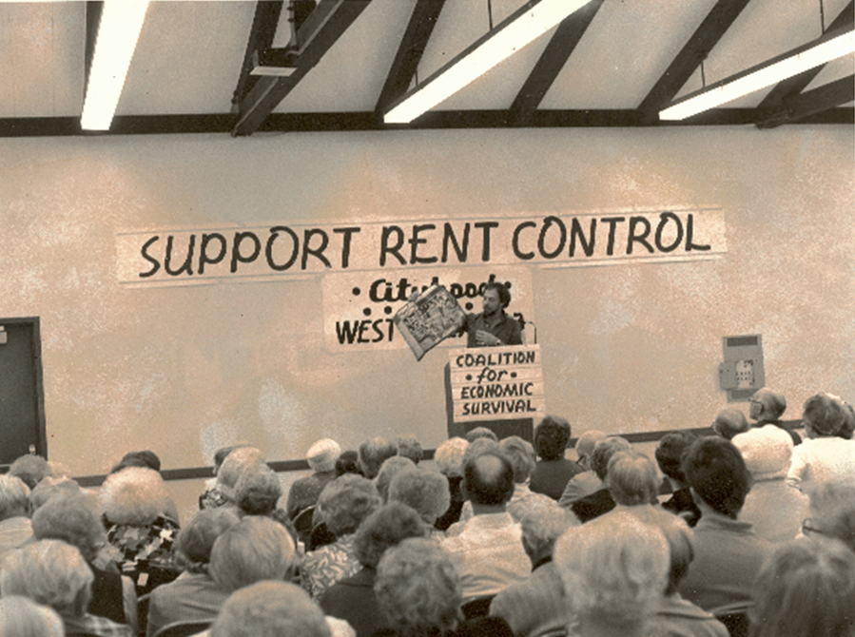
So Why Are There Price Ceilings?
They do benefit some people (who are typically better organized and more vocal than those who are harmed by them).
Government officials often do not understand supply and demand analysis, or ignore it.

Slide 7
Try this:
Let’s try this: Price Ceiling: Roses
The supply and demand equations for roses are given by Qs = 3P-10 and Qd = 20- 2P respectively, where P is dollars per dozen roses, and Q is dozens of roses in hundred thousands.
What is the equilibrium market price and quantity of roses sold?
What is the consumer surplus and producer surplus?
b) Suppose the government decided to make roses more affordable, and sets price ceiling at $4 a dozen. Calculate the deadweight loss (the welfare loss to the society).

Slide 8

Price Floors
Sometimes governments intervene to push market prices up instead of down.
The generous minimum wage in many European countries has contributed to a high rate of unemployment and the flourishing of an illegal labor market.

Slide 9
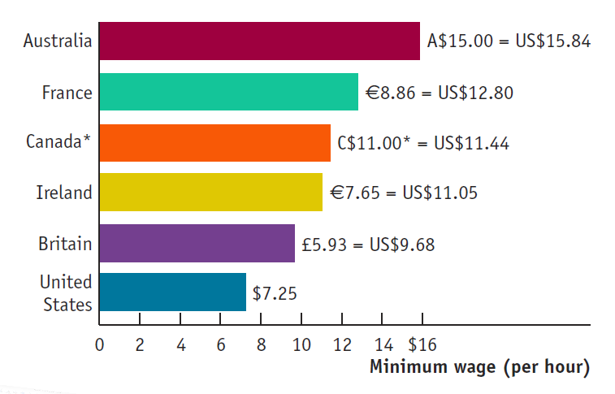
Illegal Activity
Price floors encourage black markets.
There are willing sellers (and buyers) at illegal prices, so they are tempted to break the law
In Spain it’s estimated that one-third of the “unemployed” have under-the-table jobs.

Slide 10
The Market for Butter in the Absence of Government Controls
Quantity of butter
Price of butter
(per pound)
(millions of pounds)
Price of butter
Quantity demanded
Quantity supplied
(per pound)
S
$1.40
8.0
14.0
$1.40
$
1.30
8.5
13.0
1.30
$
1.20
9.0
12.0
$
1.10
9.5
11.0
1.20
$
1.00
10.0
10.0
1.10
$
0.90
10.5
9.0
E
$
0.80
11.0
8.0
1.00
$
0.70
11.5
7.0
0.90
$
0.60
12.0
6.0
0.80
0.70
0.60
D
0
6
7
8
9
10
11
12
13
14
Quantity of butter (millions of pounds)

Slide 11
The Effects of a Price Floor
Price of butter (per pound)
$1.40
Butter surplus of 3 million pounds caused by price floor
S
Price Floor:
1.20
A
B
E
Price floor
1.00
0.80
0.60
D
Quantity of butter (millions of pounds)
0
6
8
9
10
12
14
The surpluses lead to lower prices $0.90, as suppliers are willing to sell lower price.
Inefficiency: Deadweight Loss: the triangle area to the left of Equilibrium E,
= ½ x (1.20-0.90) x (10-9).

Slide 12
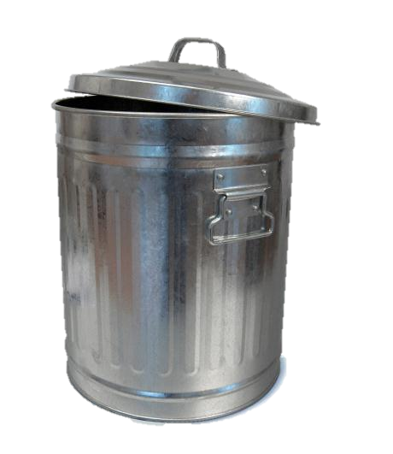
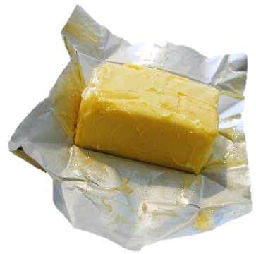
Wasted Resources
Price floors encourage waste.
To deal with the surplus generated by agricultural price floors, the U.S. government sometimes buys back the excess and donates or destroys it.

Slide 13

How Price Ceilings Cause Inefficiency
Price ceilings cause predictable side effects:
Inefficiently low quantity
Inefficient allocation to customers
Inefficiently low quality
Black markets
Wasted resources

Slide 14
How a Price Floor Causes Inefficiency
Price floors cause predictable side effects:
inefficiently low quantity
Inefficient allocation of sales among sellers
Wasted resources
Inefficiently high quality
Temptation to break the law by selling below the legal price

Slide 15

Inefficiently High Quality
Higher quality raises costs and reduces sellers’ profit.
Buyers get higher quality but would prefer a lower price.
Price floors encourage sellers to waste resources:
higher quality than buyers are willing to pay for
Most flyers prefer a lower ticket price (with no food included)

Slide 16
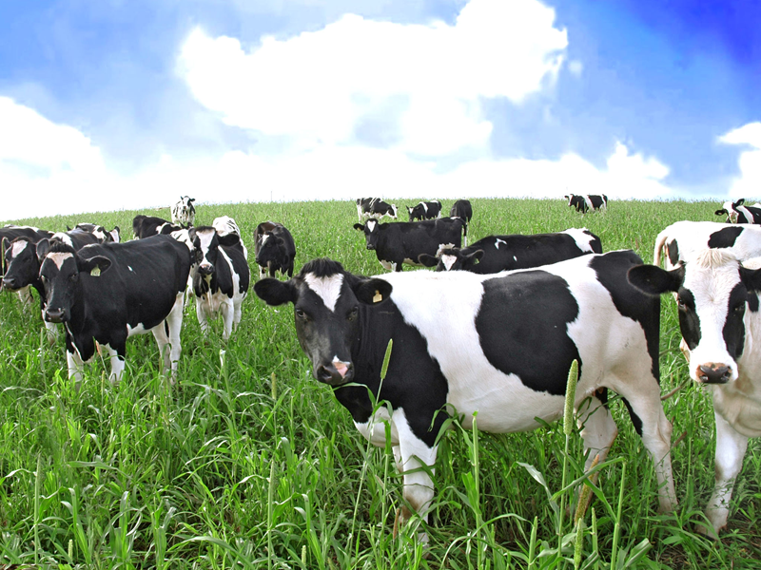
So Why Are There Price Floors?
Same as price ceilings:
They do benefit some people (who are typically better organized and more vocal than those who are harmed by them).
Government officials often do not understand supply and demand analysis, or ignore it.

Slide 17
Don’t be confused:
price ceilings , price floors, and quotas.
Similarity: all decrease the quantity traded.
But, Differences:
A price ceiling pushes the price of a good down; fewer sellers will want to sell; shortages led to higher price.
A price floor pushes the price of a good up; fewer buyers will want to buy; surpluses led to lower price.
A quota, by definition, reduces quantity of sales.

Slide 18
QUOTA: Controlling Quantities
Governments sometimes control quantity instead of price.
Quota: an upper limit, set by the government, on the quantity of some good that can be bought or sold; also referred to as a quantity control.
Quota limit: the total amount of a good under a quota or quantity control that can be legally transacted.
License: the right, conferred by the government, to supply a good.

Slide 19
Effect of a Quota on the Market for Taxi Rides
Fare
(per ride)
Quantity of rides
(millions per year)
Fare
Quantity demanded
Quantity supplied
(per ride)
$7.00
S
$7.00
6
14
6.50
A
$
6.50
7
13
6.00
$
6.00
8
12
5.50
The wedge
E
$
5.50
9
11
5.00
$
5.00
10
10
4.50
$
4.50
11
9
4.00
B
$
4.00
12
8
3.50
$
3.50
13
7
3.00
D
$
3.00
14
6
Quota
A: Demand Price
B: Supply Price
0
6
7
8
9
10
11
12
13
14
Quantity of rides (millions per year)
The Wedge, or Quota, rent: the difference between the demand price and the supply price at the quota limit. Equal to the market price of the license when the license is traded.

